Slide 1
CONTENTS
Vision
2024 OKR and Focus Areas
DSO Status per director
Technical Sessions
Automation Progress
Training and references

Slide 2




Vision
Implement Lean practices through DSO maturity coverage and IT Automation.
Increased operating speed and flexibility, release-on-demand, and first-time quality of secure-by-design applications.
Reduced hours and improved efficiency through automation

Slide 3




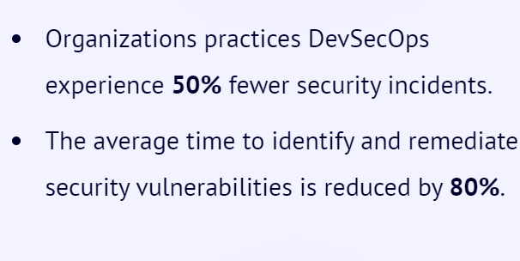
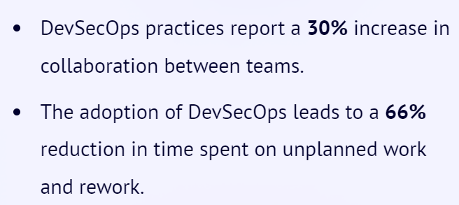
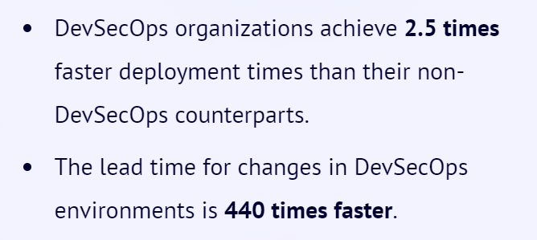
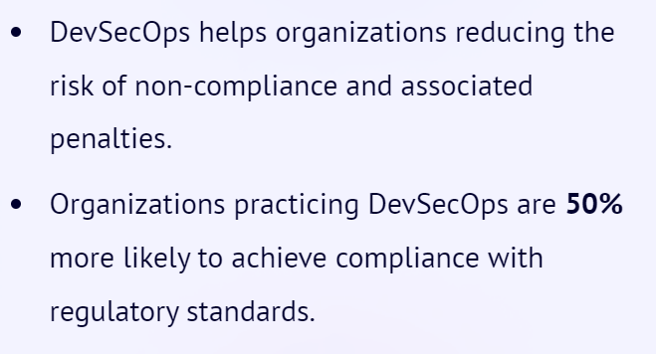
Why Implement DevSecOps?
Improved Security
Collaboration
Time to Market
Compliance
Notes:
Source:1) DevSecOps Community Survey
2) Puppet State of DevOps Report (https://www.puppet.com/resources/state-of-devops-report)

Slide 4
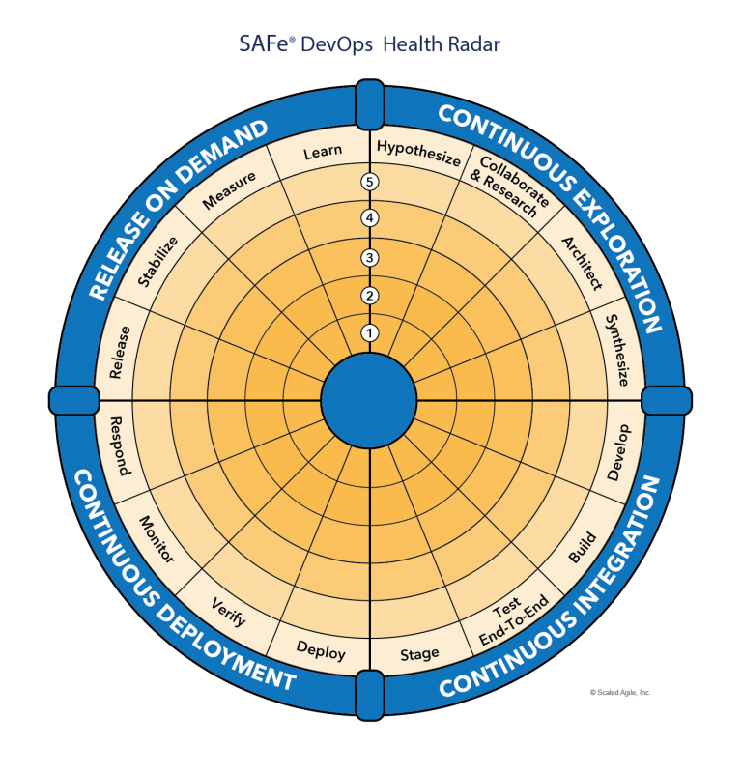
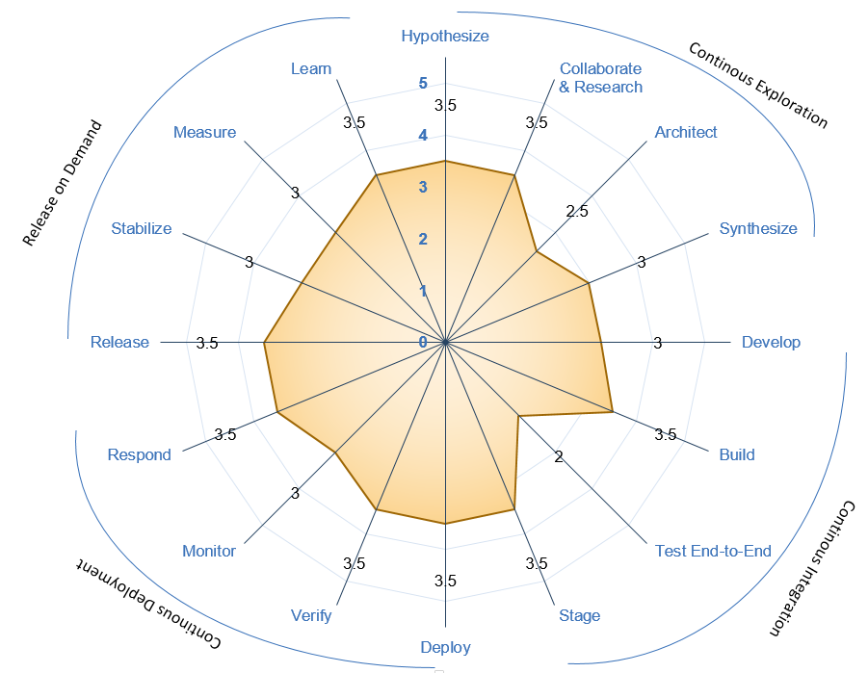





Understanding DevSecOps Maturity
Maturity Level | Stage | Stage Adoption | % of Adoption
Level 1 (Sit) | Initial | Yet to Start; Traditional environment and mindset | <=20%
Level 2 (Crawl) | Emerging | Beginning of change and agility; Initiated automation; | 21%-50%
Level 3 (Walk) | Practicing | Started Practicing; Transformation happening with defined process and automation | 51%-70%
Level 4 (Run) | Optimizing | High in Adoption ;Optimizing the existing practices and following Continuous improvement | 71%-90%
Level 5 (Fly) | Leading | Being a leader in adoption; | >90%
Recommended minimal level for DSO Adoption
Maturity Level
Sit
Level 1
Crawl
Level 2
Walk
Level 3
Run
Level 4
Fly
Level 5
1- Low & 5-High Maturity

Slide 5
2024 OKR AND FOCUS AREAS

Slide 6
DevSecOps
1- Improve maturity for business critical applications
to Level 3 (minimum).- focus on 10% of applications (50) that have completed Assessment.
2- Focus on DevSecOps maturity for apps already in cloud or plan to move in 2024
2- Complete assessment for product with highest ROI - 20% Remaining Apps.
3- Build Reusable libraries from learnings and success stories
4- Training and Upskilling sessions for team ( 3 per Quarter)
5- Pilot projects with Software chapter team to improve maturity
High ROI products for focus:
Jennifer
Regulatory and Safety
Tatum
System Engineering
Electrical Engineering
Customer Engineering (CE)
Buba
Digital Market Products
Technical Publications
Jeff
Embedded Program Support
Product Support Analysis
Automation
1- Improve Automation efficiency high ROI Products and bring product efficiencies.
2- Overall savings of 140K Hrs (35K/Per Director)
3- Build Lean practices and automation for Compliance , TechDebt and Compute

Slide 7
Director | Products | # Applications | Total assessments Completed | Product Maturity Level | 2023 |  |  | 2024 Target
 |  |  |  |  | Assessments Complete | Re-assesments Complete | Automation Savings | Assessments | Reassessments | Automation Savings
Jennifer | Summary | 173 | 39 |  | 16 | 5 | 83007 | 27 | 6 | 35000
 | Regulatory and Safety | 26 | 12 | 3.3 | 4 | 1 |  | 3 | 2
 | Research and Technology | 10 | 9 | 3.3 | 5 | 2 |  |  | 1
 | Test and Evaluation | 48 | 14 | 2.9 | 4 | 2 |  | 7 | 2
 | Non DTPLM | 89 | 4 | 2.6 | 3 | 0 |  | 17 | 1
Tatum | Summary | 425 | 149 |  | 80 | 17 | 23160 | 56 | 22 | 35000
 | Authoring Process Planning | 21 | 16 | 3.5 | 10 | 4 |  | 1 | 2
 | Data Distribution and Management | 60 | 19 | 2.9 | 1 | 0 |  | 8 | 3
 | Automation Programming | 24 | 4 | 3.2 | 0 | 0 |  | 4 | 1
 | Customer Engineering (CE) | 9 | 0 | NA | 0 | 0 |  | 2 | 0
 | DT PLM | 17 | 14 | 3 | 7 | 6 |  | 1 | 2
 | Electrical Engineering | 63 | 6 | 3.4 | 0 | 0 |  | 11 | 1
 | Flight Engineering and Propulsion | 132 | 62 | 1.9 | 60 | 0 |  | 14 | 9
 | Mechanical and Structural Engineering | 46 | 6 | 2.9 | 1 | 0 |  | 8 | 1
 | Systems Engineering | 33 | 5 | 3.7 | 0 | 1 |  | 6 | 1
 | Production System Simulation | 1 | 1 | 2.5 | 1 | 0 |  | 0 | 0
 | Visualization and xR | 19 | 16 | 3 | 1 | 6 |  | 1 | 2
Buba | Summary | 166 | 70 |  | 19 | 7 | 65343 | 20 | 10 | 35000
 | Digital Market Products | 54 | 22 | 3.6 | 5 | 1 |  | 6 | 3
 | Customer Operations | 24 | 16 | 3.1 | 2 | 1 |  | 2 | 2
 | Technical Publications | 59 | 23 | 3.1 | 8 | 5 |  | 7 | 4
 | Training & Other | 35 | 9 | 3.1 | 4 | 0 |  | 5 | 1
Jeff | Summary | 187 | 76 |  | 14 | 3 | 12760 | 27 | 12 | 35000
 | Automation Programming | 26 | 26 | 3.2 |  |  |  |  | 4
 | Innovation Hub |  |  | NA
 | Material Management | 18 | 9 | 3.7 | 0 | 0 |  | 2 | 1
 | Maintenance Repair and Overhaul | 24 | 12 | 3.1 | 1 | 1 |  | 2 | 2
 | Integrated Logistics Planning and Management | 35 | 11 | 3.4 | 1 | 0 |  | 5 | 2
 | Product Support Analysis | 32 | 7 | 3.5 | 4 | 0 |  | 5 | 1
 | Embedded Program Support | 78 | 11 | 3.3 | 8 | 2 |  | 13 | 2
E&PS Summary |  | 982 | 334 |  | 130 | 32 | 184270 | 131 | 50 | 140000 Hrs

Slide 8
Bringing efficiency at product
Product Efficiency
Compliance
Tech Debt
Compute
DevSecOps & Automation
Application Roadmap
/retirement
Cloud
Look ahead
Work with DRI support across areas to identify opportunities of automations

Slide 9
Strategy & improvements
Opportunity for technical leaders and Product/Project managers to be part Initiative.
Continue collaboration with EA Team for governance and improvements at IT&DA
DevSecOps & Automation
Governance & Collaboration
Product Centricity
Rewards
Training & upskilling
Communication
Communication to all employees on progress and importance Initiative.
Establish OKR at products
Product manager to drive higher maturity for applications and Track status in QBR
Focal to be assigned and collaborate with Product leaders to help on product maturity improvements
Resources and sessions for all employees.
Focused trainings for focal.
Hands-on experience to focal for their development and growth
Rewards for products & application team
Rewards for Core team

Slide 10
Progress
On Track
Watch Item
Off Track
Q1
2024 OKR Targets
Target
Completed
Complete DSO Assessments for new applications 131 Apps
30
01
Implementation roadmap for Applications that have completed assessments- 90 Apps
30
01
Roadmap implementation , Re-Assessment & ROI calculation for 15% Apps with roadmap created: - 50 apps
10
01
*DSO Improvements pending
Maturity improvement and maintain Score 3.0+
Maturity Score 3.95

Slide 11
Assessment Process
DevSecOps Assessment Process Flow (Swimlane)
Please refer to the attached PDF.
GSEP Process for Dashboard Access
Please use the link to get access to the assessment dashboard. This is an auto approval process. Please select the first option for Business Stakeholder group.
Try to access this Dashboard Link after few minutes.

Slide 12
Assessment OVERVIEW
The DevSecOps Maturity Assessment is:
Designed to meet IT&DA’s objective to lead Boeing’s transition to a Product-Centric and Cloud model enabled by matured DevSecOps practices
Derived from software architecture models developed by OWASP, Synopsys, and Scaled Agile, Inc. and recommended by Gartner, McKinsey and Boeing InfoSec SMEs
Determines how well a software product team has aligned their activities with those recommended by the industry best practices in their Continuous Delivery Pipeline
Used by industry-leading technology product teams all over the world, to improve deployment cycles, without compromising reliability and security.

Slide 13
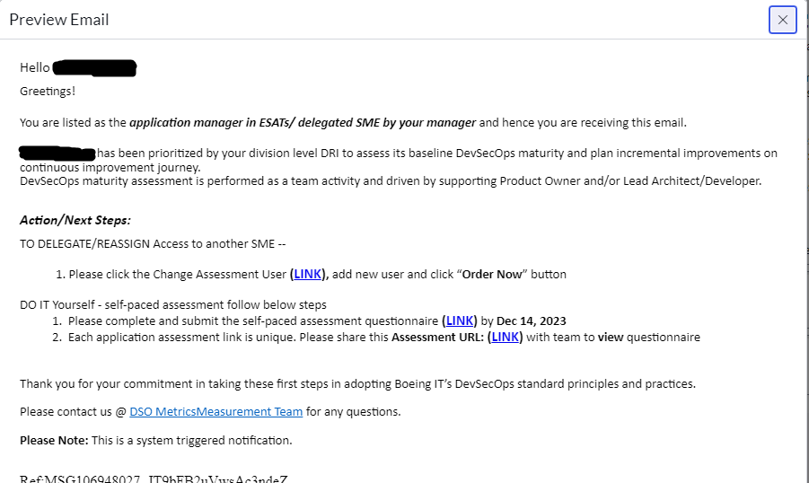
ASSESSMENT INITIATION

Slide 14
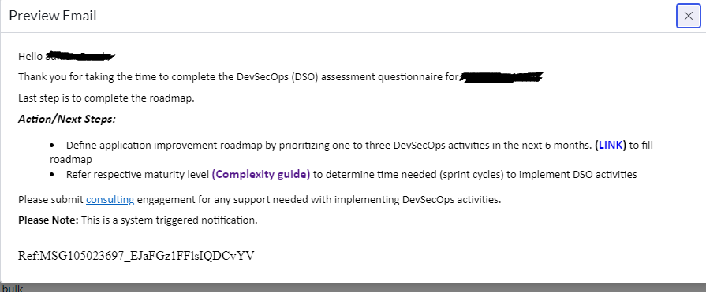
ASSESSMENT QUESTIONNAIRE COMPLETION

Slide 15
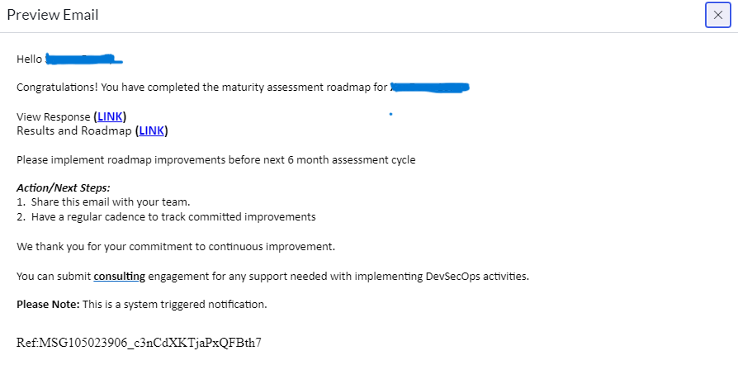
ROADMAP COMPLETION

Slide 16
CASE STUDY For SUCCESS STORY

Slide 17


Savings identified after reassessment 2023
9512 Hrs. (As of Oct 2023)
27 Applications in pipeline for reassessment in 2023

Slide 18
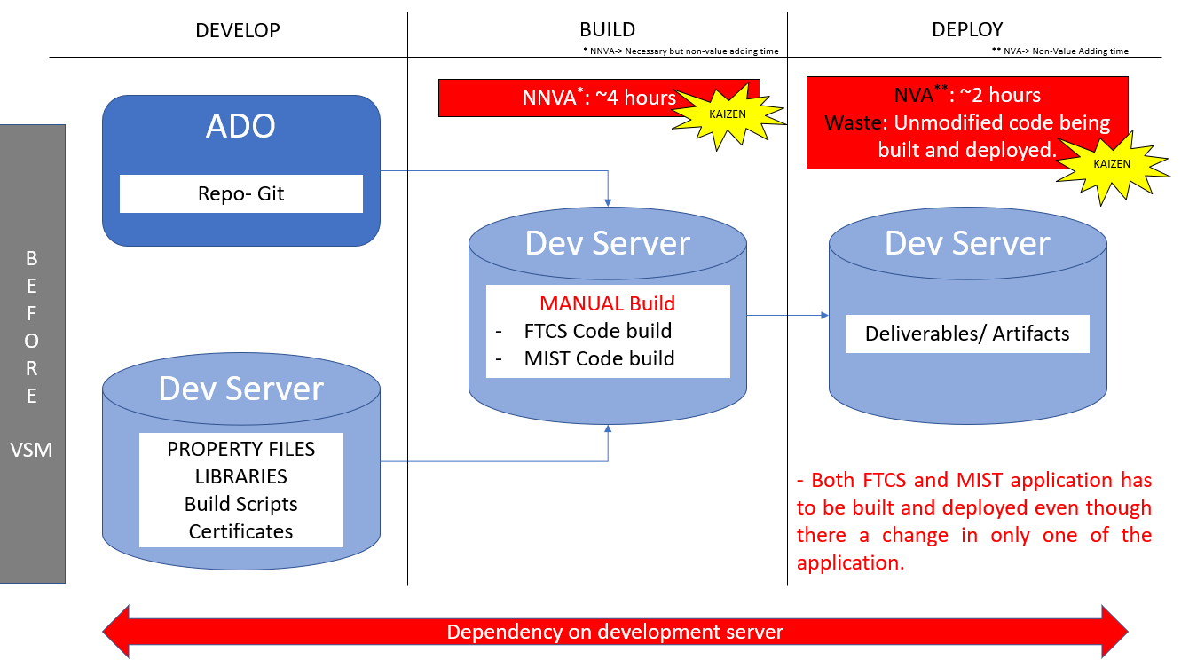
DSO improvement case study using vsm(Value stream mapping)
Challenges in Legacy apps (FTCS/MIST)
App code was in ADO and other dependencies
were maintained in dev server. Challenge in
tracking version for these dependencies.
As the apps are legacy the builds were manual
& tightly coupled.
Small change in any files required complete
shutdown of entire app for 4 hours.
Redundancy – Some Configuration files were
available in different/duplicate locations. Overhead
in maintaining.
Too much idle time and Waste - Unmodified
code being built and deployed.

Slide 19
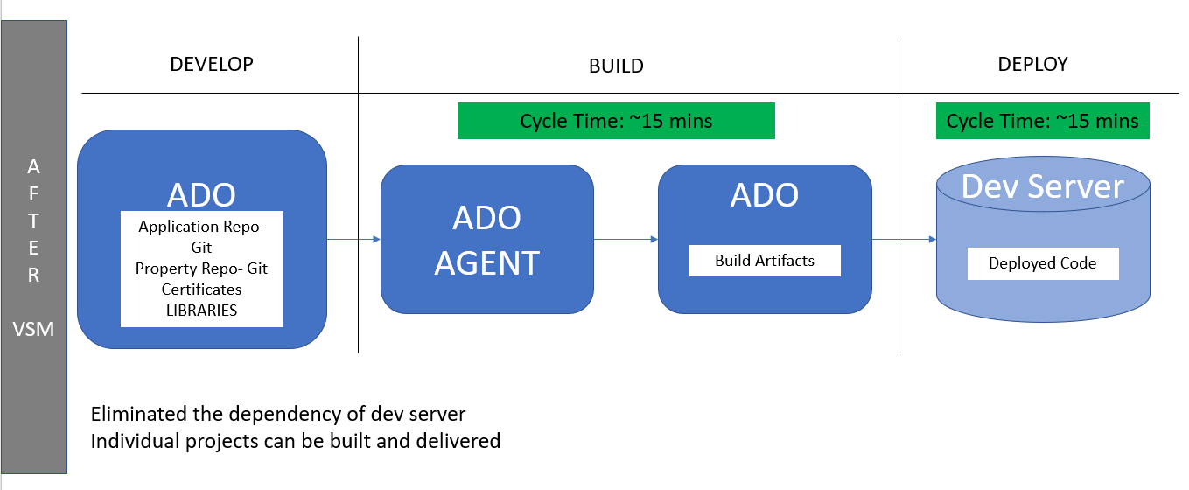
DSO improvement case study using vsm (Value stream mapping)
Mitigating challenges in legacy apps
Migrating app code and other dependencies at to
one place in ADO. Eliminated the dependency of
DEV server during build.
Maintaining and versioning of config files are now
easy with GIT support. Redundancy and overhead is
reduced.
Build process was automated using ADO build
agents, reducing the waste and downtime of the
applications. Need to rebuild unmodified apps is
eliminated by reuse of artifacts from previous build.
Configuration changes (like DB credentials,
WSSO config changes etc) are implemented by
server restarts than build and deploy.
“Build Once; Deploy Anywhere” strategy adopted
with the help of CI-CD implementation.

Slide 20
FTCS – (Flight Test Configuration System) Success stories L2 ( 34% to 46%) Total Savings In A Year 896 hours = (640 CI/cd + 256 development)
Configuration Management Practice followed which increases agility, both on the part of individual developers and the application as a whole.
Features:
Externalized
Environment Specific
Consistent
Version History
Jar Signing
CI/CD
Development
4 Non-Production Deployment
Manual Effort = 2 hr/build
Automated = 0.75 hr/build
Savings Per Sprint =
4env * 8build *1.25hrs = 40 hrs
Sprints/year= 16
Savings/year= 640 hrs
SAST tool in pipeline helps to ensure no new security vulnerabilities go to Production and quality defects early in the software development.
Coverity Pipeline Savings:
2 (coverity scans) X 8 hrs = 16 hrs/sprint

Slide 21
MIST – (Modular instrumentation setup tool) Success stories (l1 to l3) Total Savings In A Year 2304 hours = (1536 CI/cd + 768 development)
Configuration Management Practice followed which increases agility, both on the part of individual developers and the application as a whole.
Features:
Externalized
Environment Specific
Consistent
Version History
CI/CD
Development
4 Non-Production Deployment
Configuration Management Practice followed.
Manual Effort = 5 hr
Automated = 1.5 hr
Per Sprint(4env*4hr*8build=128 hr)
SAST tool in pipeline helps to ensure no new security vulnerabilities go to Production. Address security and quality defects early in the software development.
8 Story Point Task X 8 hrs = 64 hrs

Slide 22
AUTOMATION PROGRESS

Slide 23




Automation 2024
Implement automation capabilities through out the applications and achieve 80000 automation hours
OKR
Objective
Accomplishments:
Automate repetitive processes
Automation hours of 184270 has been accounted in the CoP.
Capture automation to Return On Investment.
Knowledge sharing and bring culture of Automation

Slide 24
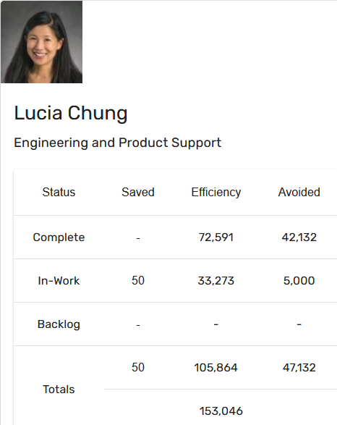
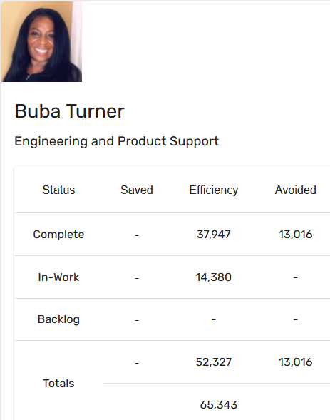
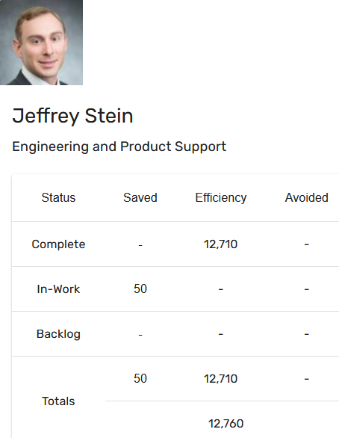
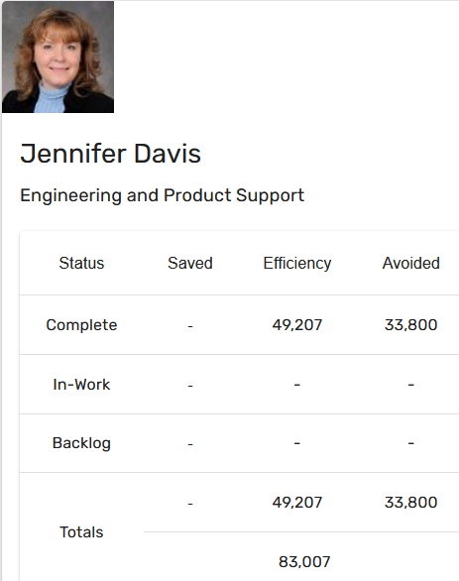
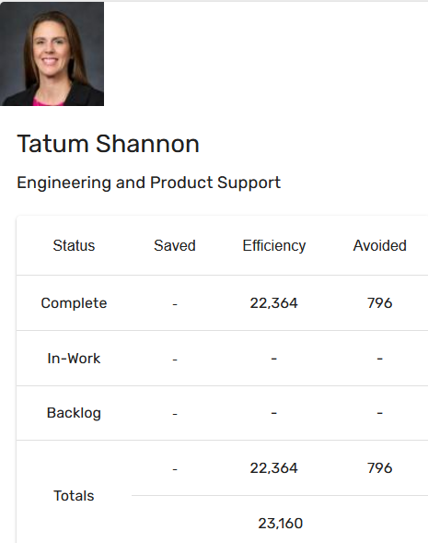
Automation Status - 2024
Target: 80k hrs
Current status: 184k hrs
Total : 184270 hours

Slide 25
Training and references

Slide 26
Training and support
Automation COP
https://devsecops.web.boeing.com/index.html [DevSecOps Enterprise Website]
Training:
https://devsecops.web.boeing.com/trainings.html
https://insite.web.boeing.com/culture/viewMedia.do?mediaId=428840
Insite: DevSecOps related video series
Degreed: https://degreed.com/pathway/mpl66o5r9d/pathway
Oreilly: https://learning.oreilly.com/library/view/the-devops-handbook/9781457191381/
Enterprise Support
In case of any queries interested teams can register themselves through EMC (check for the session with the name “DevSecOps Office Hours (India)”).
For Product Teams in US, Click Here to block your slot
For Product Teams in India, Click Here to block your slot
DSO Support Systems | Description | URL
ATOMS | Platform to onboard to some of the commonly used tools like Coverity, Netsparker, SonarQube | https://atoms.web.boeing.com/home
ATOMS-CI | Saves your team time by generating an automated continuous integration pipeline and integrating different tools | https://atoms-ci.web.boeing.com/ci
DevSecOps | Official DevSecOps website | https://devsecops.web.boeing.com/index.html
AppDynamics | Monitoring tool documentation | https://itms.pages.boeing.com/wiki/appdynamics/
Enablement kit | Architecture Checklist to improve maturity | https://devsecops.web.boeing.com/assessment/enablementKit.html
DSO Mattermost channel | Join this channel for any questions/updates | https://mattermost.web.boeing.com/dso/channels/town-square
DSO Consultation | Connect with the experts | DL DSO Consulting
DSO COE InSite Group | Join this group for any questions/updates | https://insite.web.boeing.com/culture/viewGroup.do?groupId=168061
DevSecOps Video Library | Videos on different implementation | https://insite.web.boeing.com/culture/displayGroupMedia.do?groupId=168061

Slide 27
Assessment Process
DevSecOps Assessment Process Flow (Swimlane)
Please refer to the attached PDF.
GSEP Process for Dashboard Access
Please use the link to get access to the assessment dashboard. This is an auto approval process. Please select the first option for Business Stakeholder group.
Try to access this Dashboard Link after few minutes.
Info center Dashboard Link
Refer attached excel for pending reassessments and assessments.

Slide 28
Contact us
 | DRI | Project Management | Core Team Focal | Enterprise collaboration
DevSecOps | Abhishek Singh Kenneth C Shew | Kolhar Laxmidevi Kumar Anand | Singh, Abhishek K Valiyarayil, Siby Nair, Aathira Manikandan P, Ashwini Pattanaik, Anup K Ammata, Sudhakar Bakhedi, Bharati Bahubali Balraj, Bharath K Ghosh, Saikat Ghosh, Subhabrata Gundupalli, Rajesh Reddy H D, Sarika K L, Bharath Karri, Ram Sai K-R, Rahul Kuriakose, Tintu M Kurian, Abhijith Kuruba Chandra Kumar Mistry, Ashok Nagaraju, Ganesh Nagziriya, Anshika Padmanaban Shunmugam, Nihila Abhishek Kumar Prabhat, Kumar Radhakrishnan, Chinjumol Reddy, V Sanjeev Rompicherla, Rakesh Sawant, Swapnil Ravindra Varghese, Jessy Vinukonda, Basha Jayanta Mondal DL Product Systems - DevSecOps Core Team | Karthik Tirukkoylur Sekhar Dolly Bhaskara Arun Prakash Jeyaprakash Anandapadmanabhan Gopalakrishnan Sushil Mishra Donald R Wellington DL DSO DRIs
Automation | Kenneth C Shew Naga Harsha Kaggallu | Priyanka Dhanpal Chougule

Slide 29
Thank You

